Slide 1





Learning with Technology
This presentation is directed at students in higher education who are studying Multiple Intelligences

Slide 2

Learning with Technology
Technology can be used as tools to construct knowledge to think and learn with
Technology can support personal and social meaning

Slide 3

Technology’s Usefulness
Students
  Gain new knowledge
  Engage in creative thinking activities
  Increase synthesizing skills
  Can image processes, outcomes, and possibilities
  Can elaborate on information
  Can add personal meaning to information

Slide 4

Technology’s Cost
Software is already in use by the school; download a 30 day free trial
Schools are already equipped with the Internet
Webcams, digital cameras and tape recorders are inexpensive
Let’s budget for Technology

Slide 5
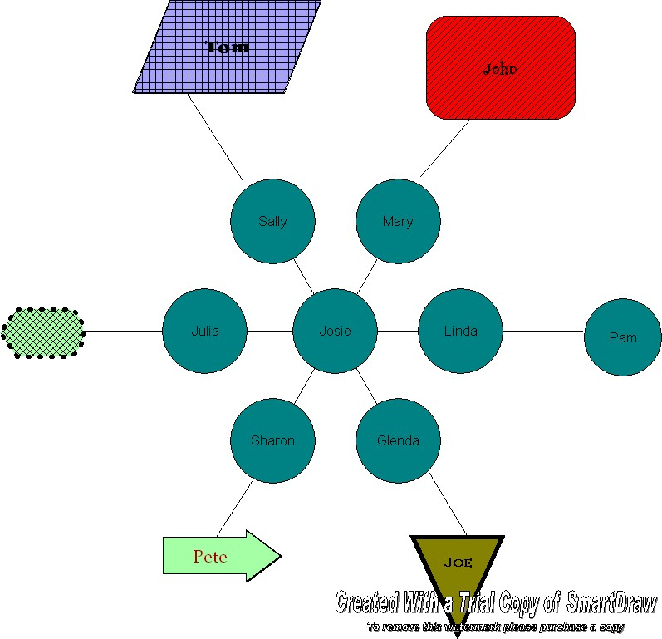
Technology’s Tools
Database software programs
Spreadsheet software programs
Simulation software
Search engines
Computer concept maps

Slide 6




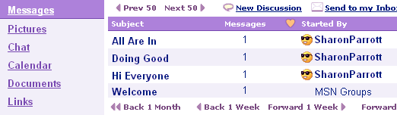
Technology’s Tools
Webcams
Digital cameras
Multimedia publishing tools
E-Mail
Bulletin boards

Slide 7

Learning with the Internet
The Internet can engage learners in meaningful learning
The Internet can be explored to search for ideas that will help to construct understanding

Slide 8

Evaluating the Internet
The Internet must be evaluated for its:
  Reliability and usefulness
  Merits of ideas or products
  Relevance or importance
  Fallacies and errors in reasoning
  Arguments and hypotheses

Slide 9
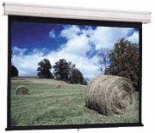
Using Technology for Science
Have students search the Internet to find scientific observations of caterpillar’s size and activities
Have the students create a PowerPoint presentation with pictures and explanations of the sizes and activities of the caterpillars

Slide 10
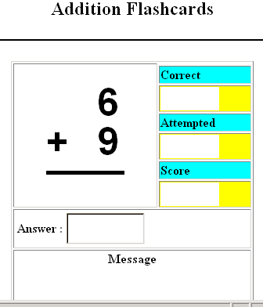
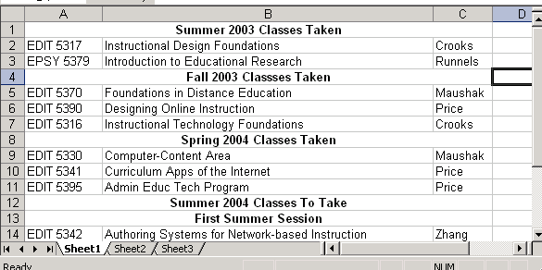
Using Technology for Math
Have students create flash cards using a desktop publishing software program
Have students track information using a spreadsheet software program

Slide 11

Using Technology for Language Arts
Have students create a skit about a book they read; video tape the skit and upload the video to the school’s website; perform the skit for another school via webcams
Example of a Video

Slide 12
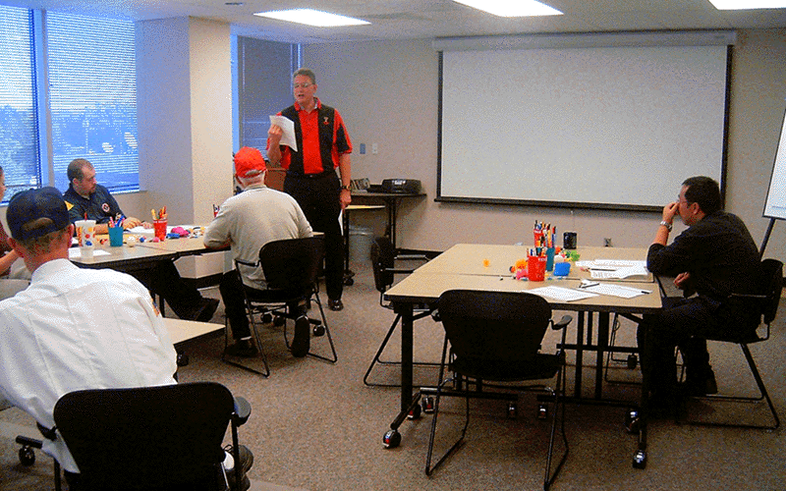
Using Technology for Business Courses
Have the students search the Internet for information on the teaching profession. Have the students take pictures of teachers at work, post the pictures on the schools’ website with information found on the Internet.

Slide 13

Using Technology for Business Computer Information Systems
Use a web authoring software program to teach students how to create a web page
Download clip art and movie sound clips into PowerPoint presentations

Slide 14
Technology
After viewing this PowerPoint presentation you should:
  Be able to recognize technology tools to use in lesson plan development
  Be able to develop lesson plans in your subject content area

Slide 15
Technology
Just remember what it was like when you were a kid and go wild with technology

